Slide 1
Advantages of using XBRL for Business Reporting in Capital Markets
CMA’s Second Conference
“Capital Markets Development” in the state of Kuwait
John Turner – CEO XBRL International

Slide 2

DISCLOSURE
BUILDS TRUST
Copyright © 2001-2017 XBRL International Inc.

Slide 3
PERFORMANCE
MATTERS
Copyright © 2001-2017 XBRL International Inc.

Slide 4
TRANSPARENCY
MATTERS
Copyright © 2001-2017 XBRL International Inc.

Slide 5
ACCOUNTABILITY
MATTERS
Copyright © 2001-2017 XBRL International Inc.

Slide 6
Variable
Business
Complexity
Variable
IT
Sophistication
Diverse Systems
Dispersed Geography
Different Business Lines
Copyright © 2001-2017 XBRL International Inc.
Different Disciplines
Different
Sizes
Different
Languages

Slide 7
WHAT IS XBRL, OR STRUCTURED REPORTING?

Slide 8
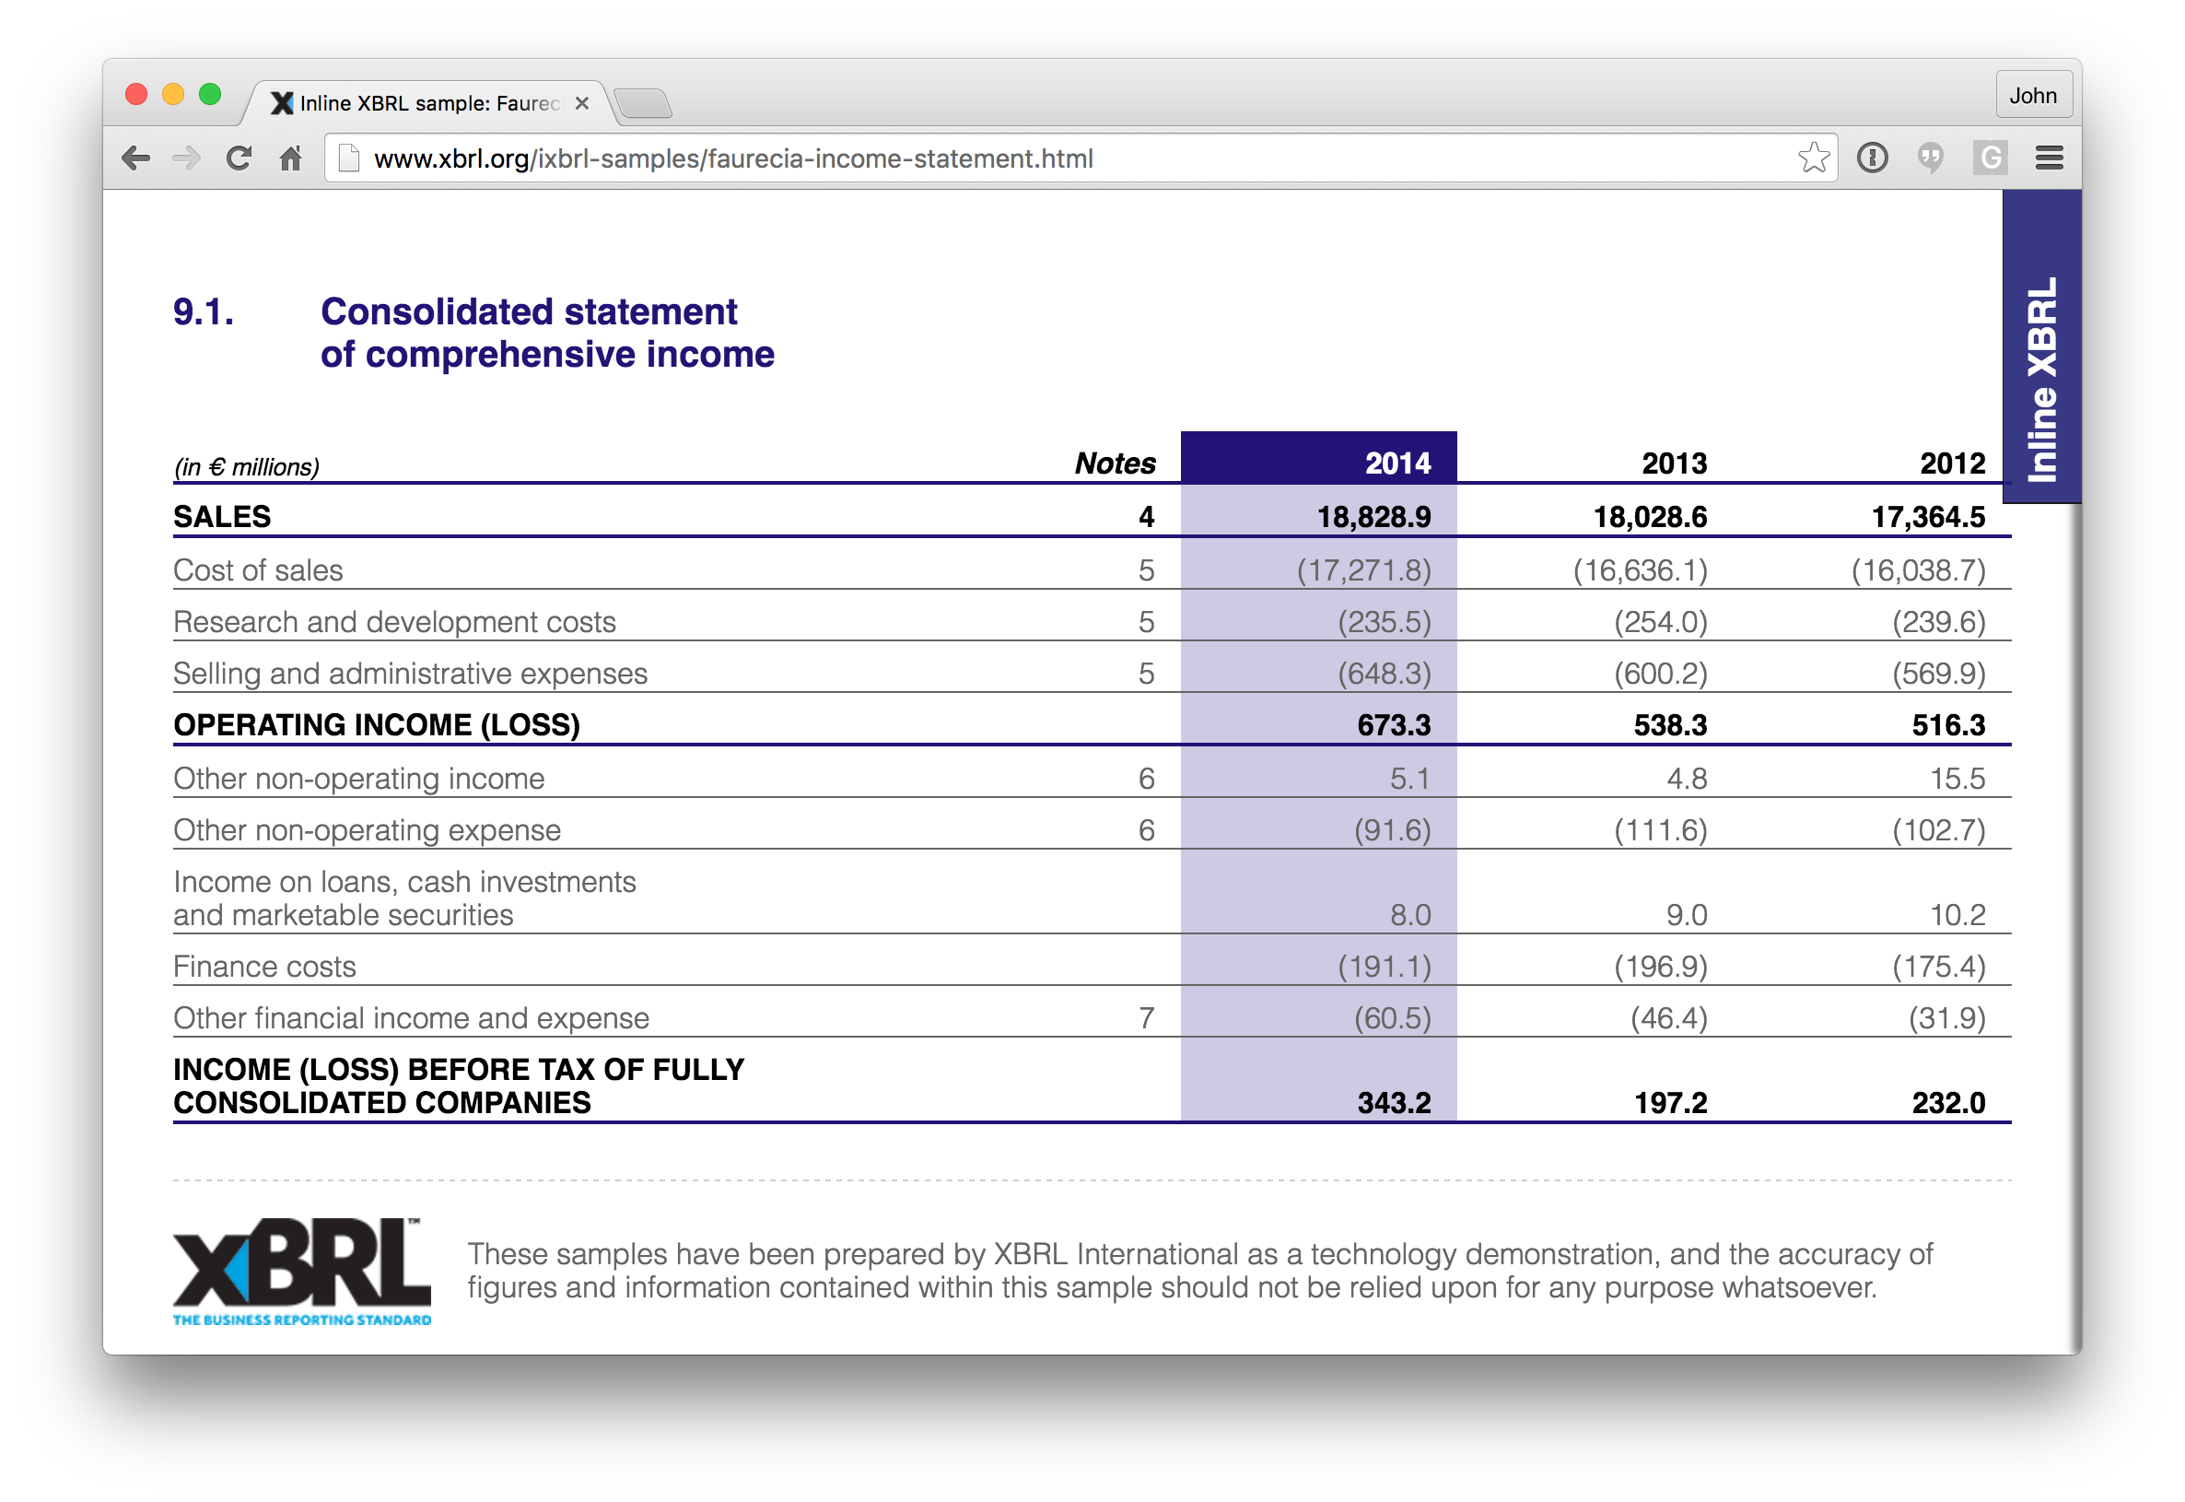

Slide 9
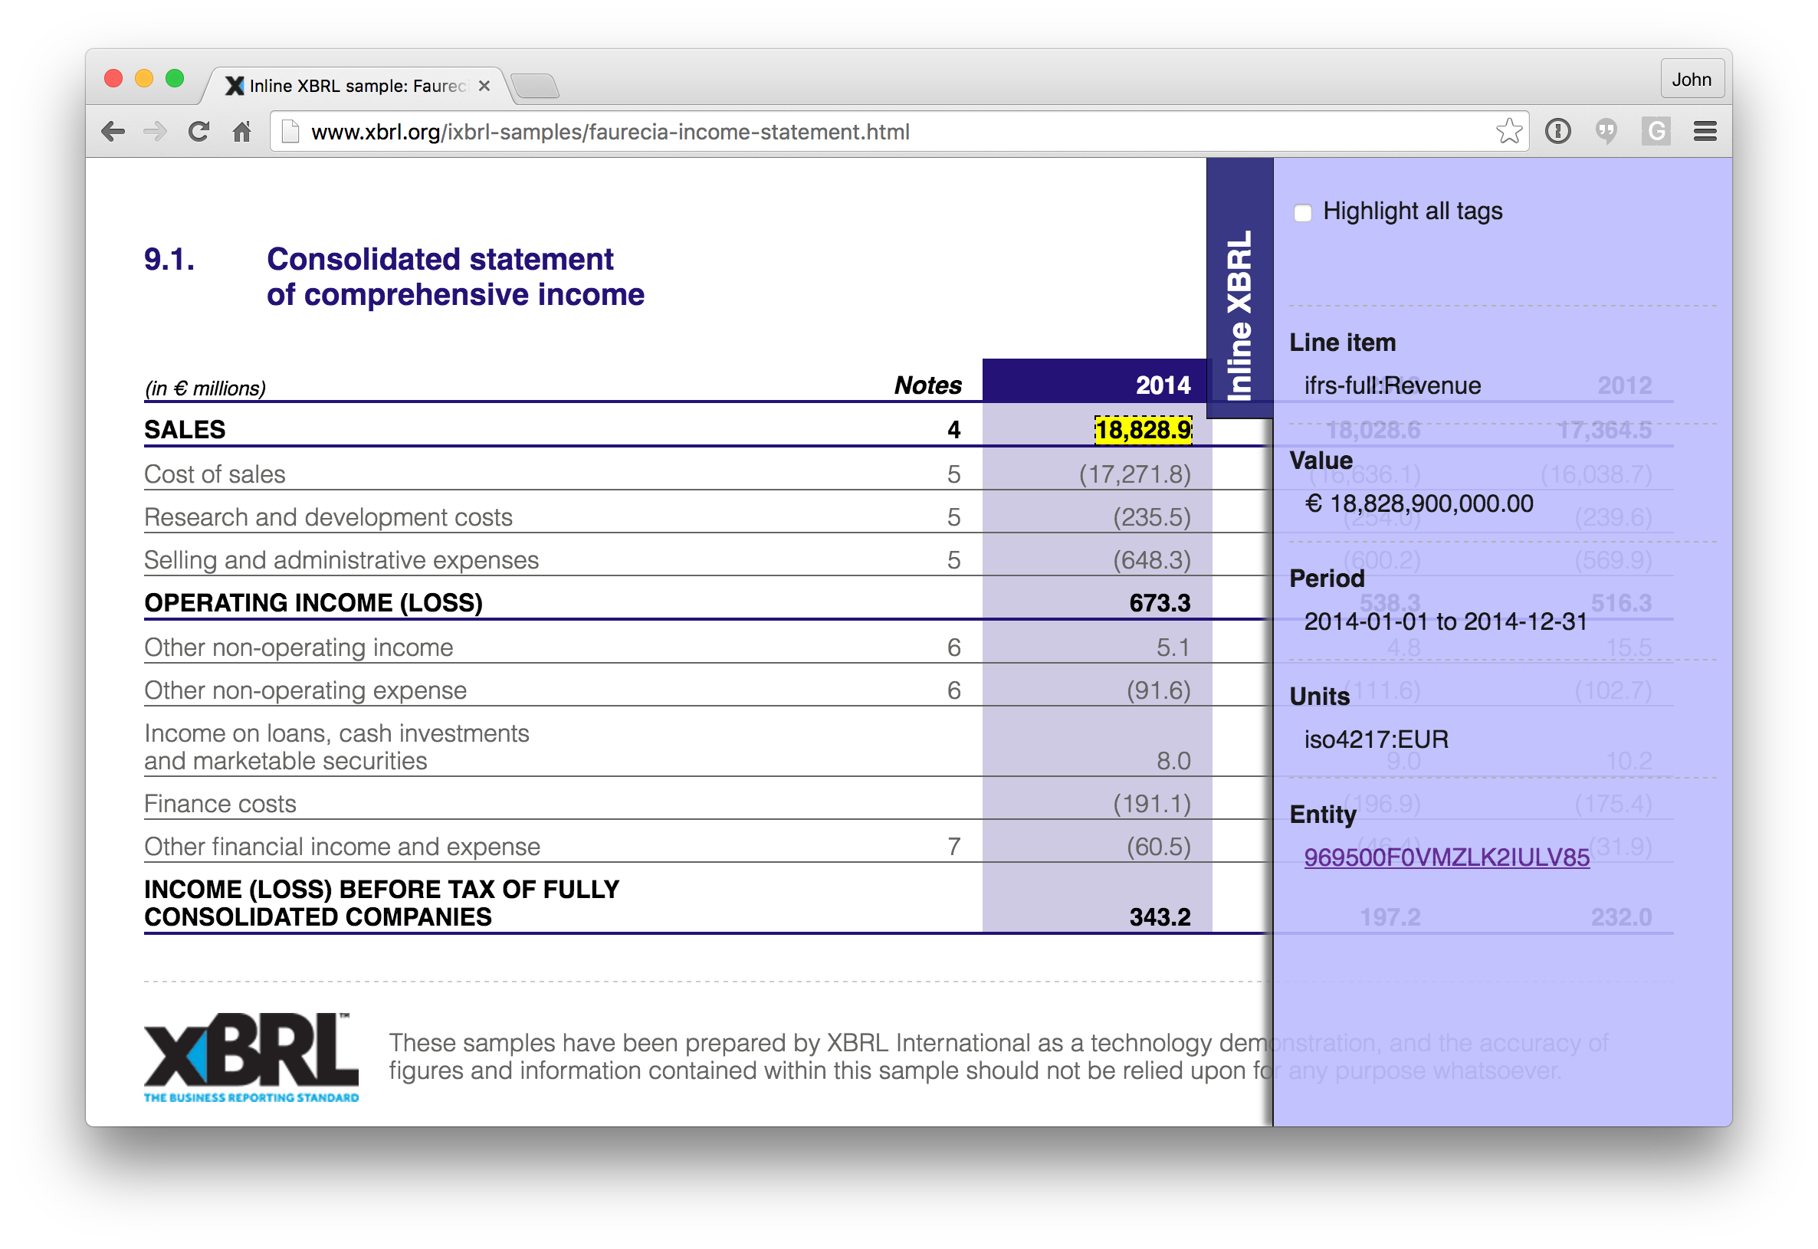

Slide 10
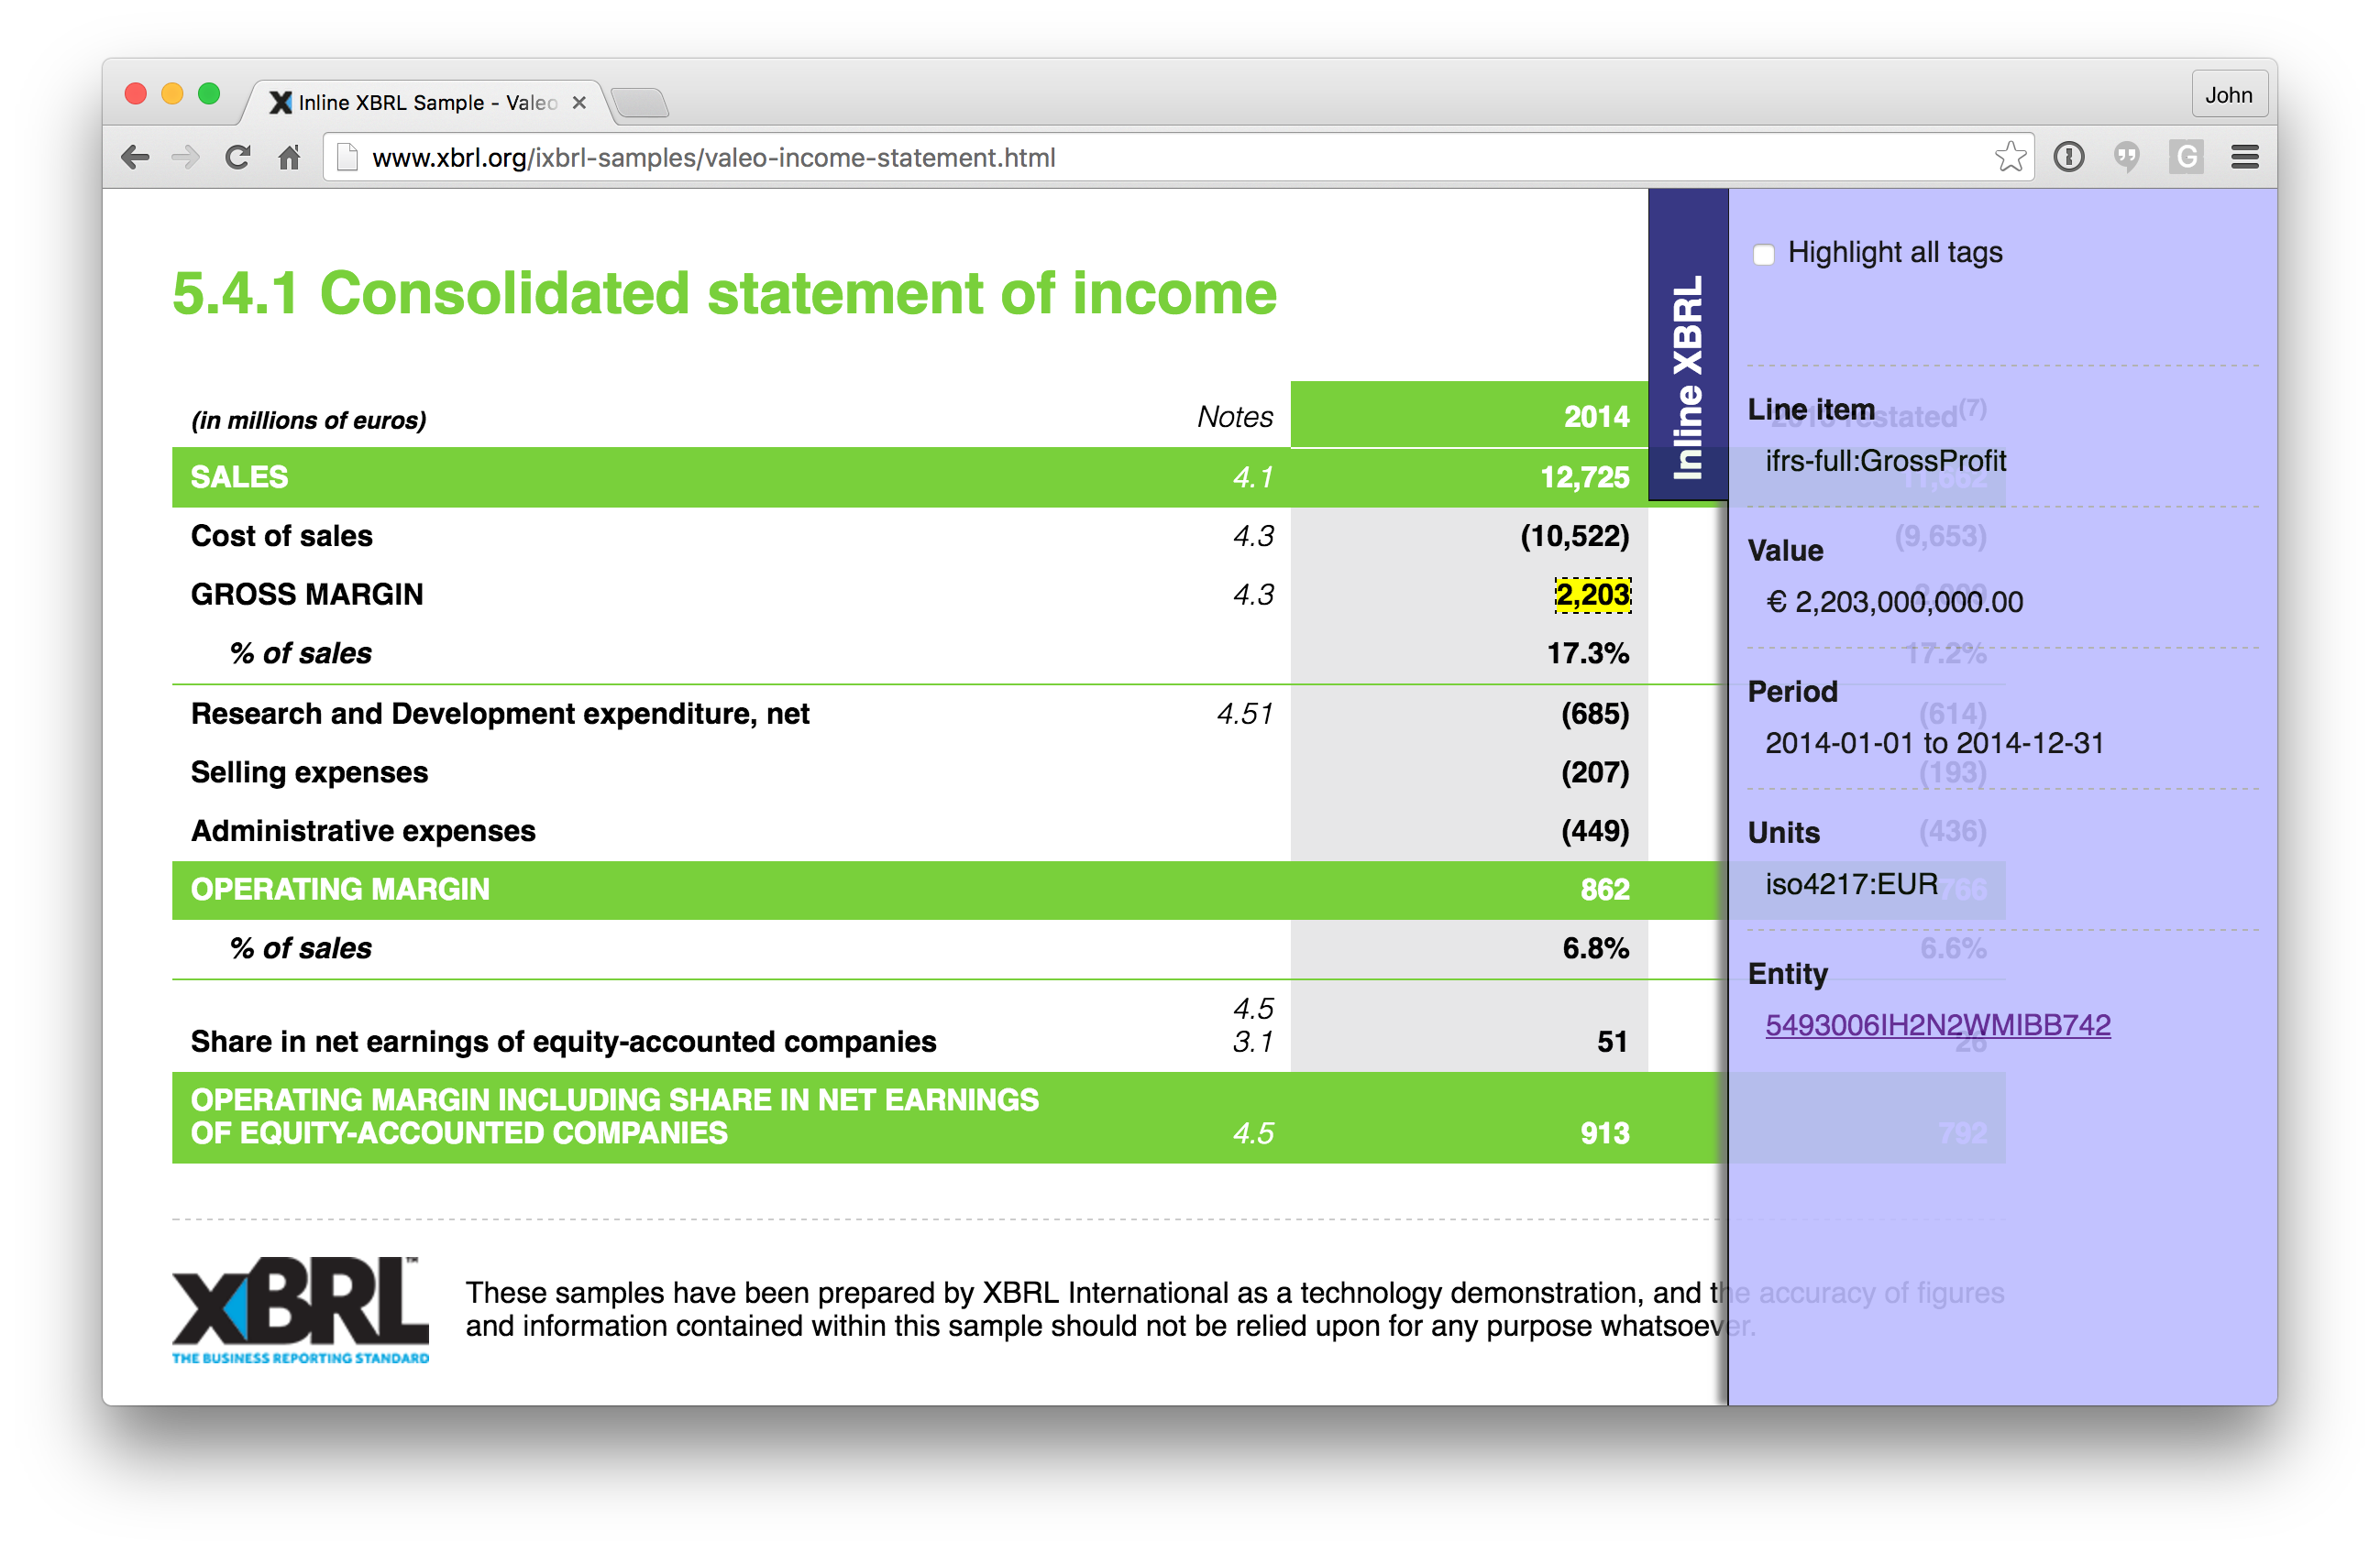

Slide 11
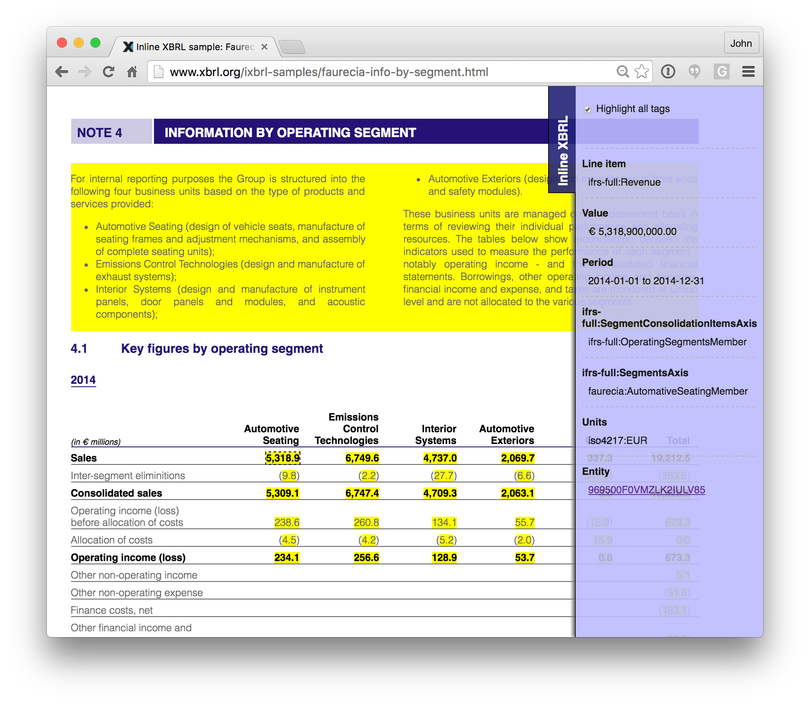

Slide 12
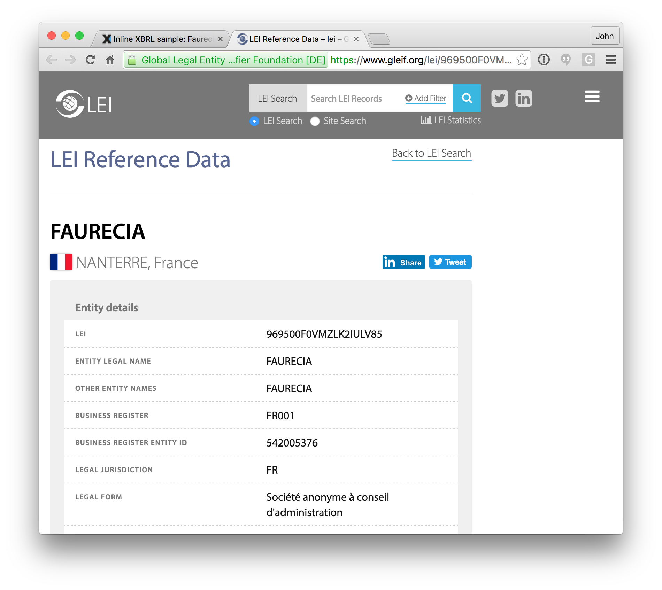

Slide 13
18,828,900,000

Slide 14
REVENUE
€
FY2014
FAURECIA
18,828,900,000

Slide 15
Revenue
IFRS
Flow
Monetary
IAS1 Para 82

Slide 16
Доход
إيرادات
Revenue
收入

Slide 17
WHY IS STRUCTURED DATA IMPORTANT TODAY?

Slide 18

VISIBILITY AND LIQUIDITY

Slide 19
Translation
русский
中文
한국어
عربي
français
english
español

Slide 21
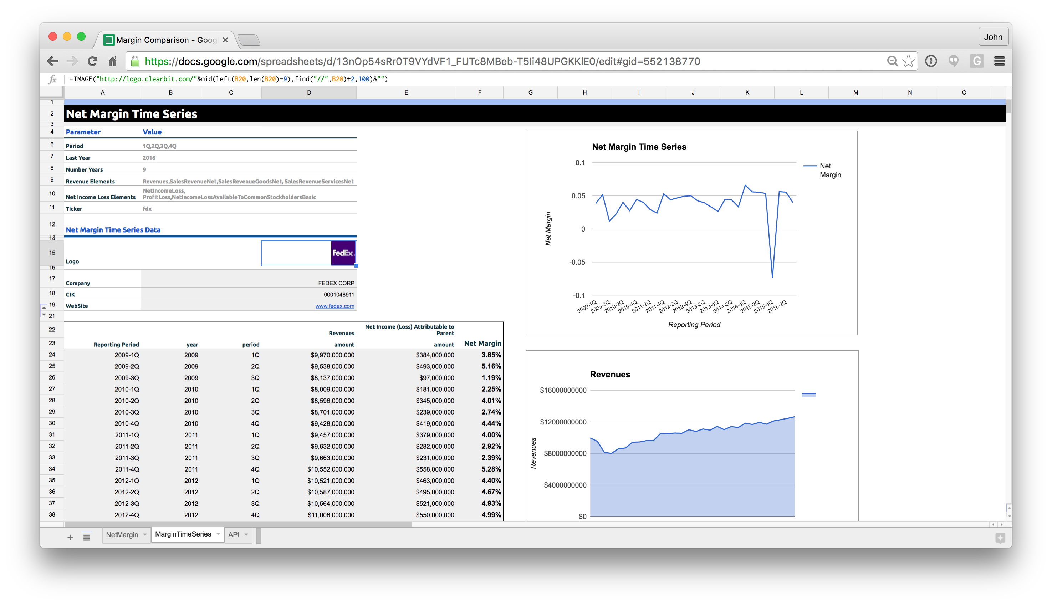

Slide 22

 | FACE FINANCIALS | FULL FINANCIALS | STP
Japan | YES | PART | YES
China | YES | NEXT | YES
Korea | YES | NO | YES
Brazil | YES | NEXT | PART
USA | YES | YES | PART

Slide 23
A progression

Slide 24

This year’s annual XBRL International conference, Data Amplified 2017, is in Paris.
Do save the date: November 6-8 2017.

